Slide 1
PRIOR AUTHORIZATION
Next steps after submission
Presented by Wendy Sprigler RN, Provider and Member Liaison Coordinator
IHCP Works Annual Seminar ‒ October 2024

Slide 2
Topics
Authorization Review Process
Pended PA
Requests for Additional Units
Transferring PAs Between Providers
Hospice Member Disenrollment from Managed Care
Retroactive PAs
PA with Third-Party Liability
Administrative Review (AR) and Appeal Process
Common Denials
Helpful Links
Questions

Slide 3
Authorization Review Process

Slide 4
Turnaround Times
Standard Request
Expedited / Concurrent
Administrative Reviews
Retrospective
Five business days
Forty-eight hours
Thirty calendar days
Seven business days

Slide 5
Review Process Overview
All documentation and criteria/requirements are reviewed.
If any required documentation is required, clinical reviewer will pend to the provider. (This will be covered in depth later)
Once all documentation is submitted, the reviewer determines if they can approve request against criteria.
If the clinician cannot approve the PA based on criteria hierarchy the case is sent to a physician to review for medical necessity.
All submitted documentation is reviewed and the medical director’s decision is returned to the clinical reviewer.
The clinical reviewer enters the decision into the case in Atrezzo and completes the determination letters.

Slide 6
Letters
Letters are generated at the time of completion.
If submitted via portal, notice of case status change and letter creation is sent to the user who submitted the case.
View/download authorization letter within case (under Attachments-Letters).
Letters are then mailed to the following:
Member.
Requesting provider address on file.
Rendering provider address on file.
Attending physician (if entered in the case).
Letters no longer contain PA numbers, but PA number will be available in Atrezzo.

Slide 7
Pended PA

Slide 8
Pended Cases
If requested PA has insufficient information for utilization management (UM) team to review, request is pended.
Turn around time clock is stopped.
Clinical reviewer will send a letter and make a note indicating the information that is needed.
Required clinical information must be submitted via portal or by fax within 30 calendar days for standard reviews.
In portal: Upload documentation (Actions drop down/ Additional Clinical Information) or to fax: 800-261-2774.
If requested information is not received within 30 calendar days, request is rejected.

Slide 9
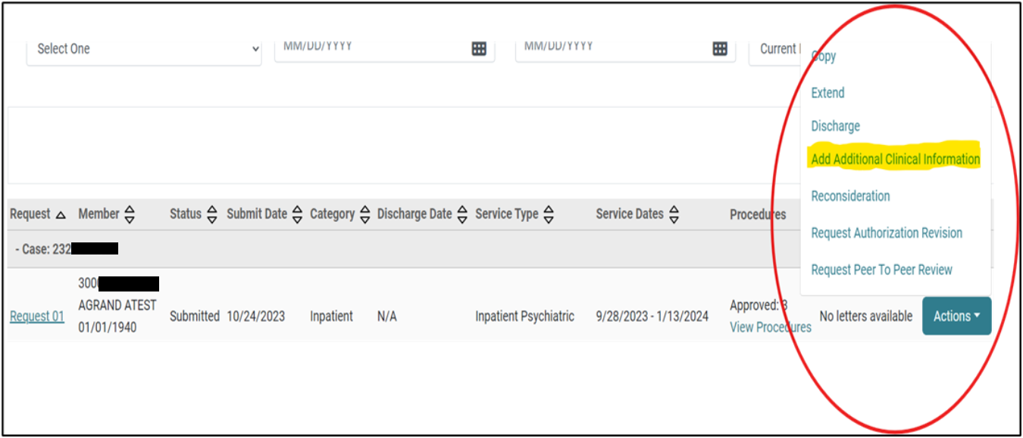
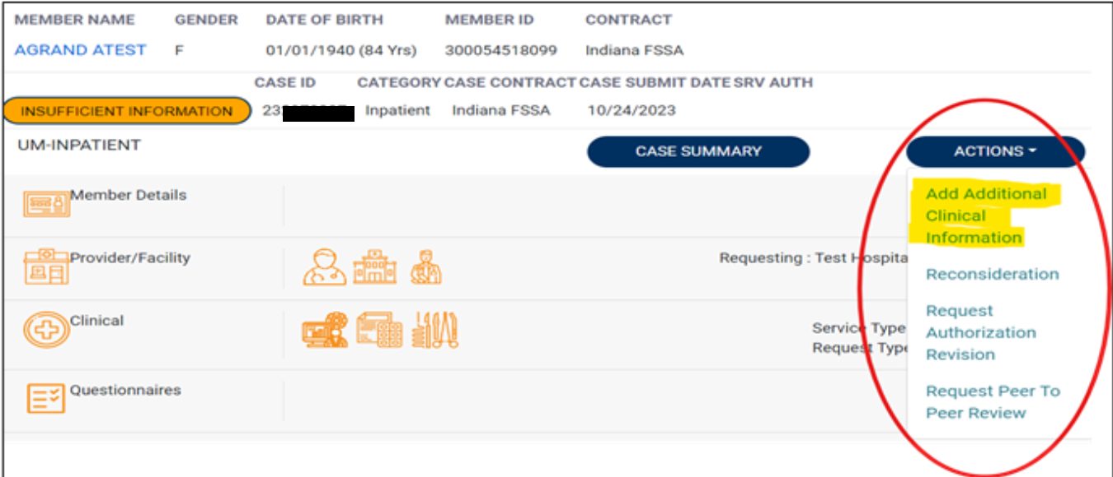
Adding Documents to Case
Select the ACTIONS drop down.
The ACTIONS dropdown can be accessed from the main screen or from within the case.
Select Add Additional Clinical Information.

Slide 10
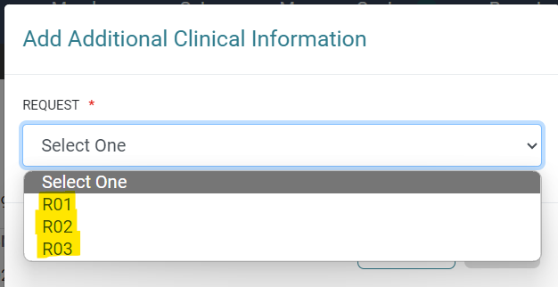
Selecting the Correct Request
Select which request line (i.e., R01, R02), generally the most recent.

Slide 11
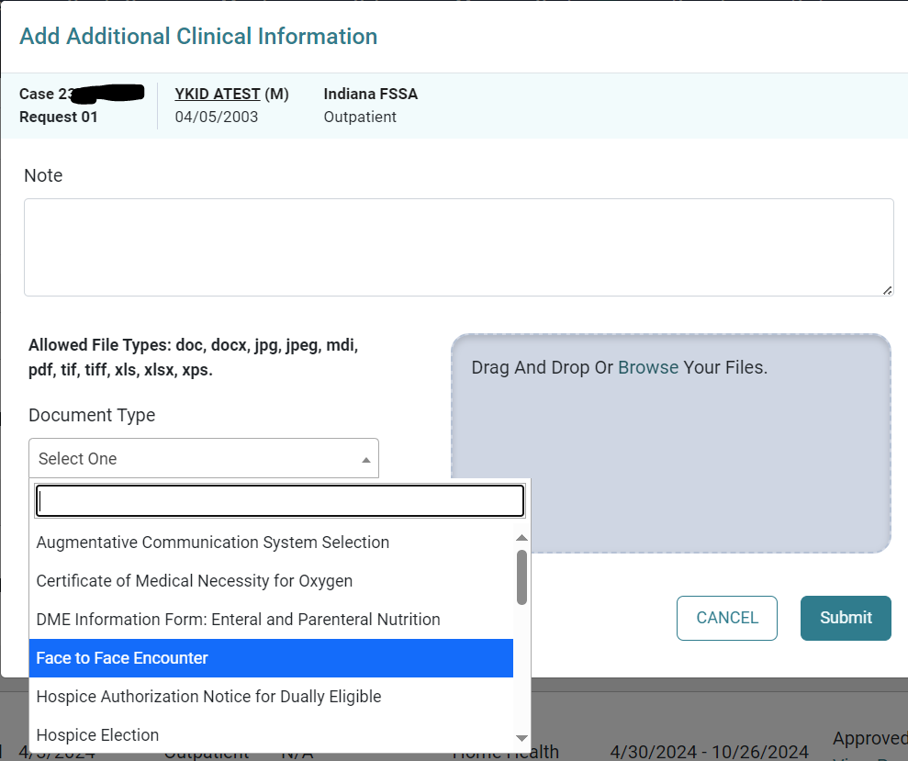
Screenshots for Uploading a File
Select Document Type being uploaded.
Browse or Drag and Drop files you want uploaded to the case.
Provider may enter a note to the clinical reviewer under the Note section.
Finish by selecting Submit

Slide 12
What Happens Next
When the additional information is submitted, the clinical reviewer will receive a task to begin the medical necessity review.
Upon receipt of the additional information, Acentra has an additional five business days for standard reviews and forty-eight hours for expedited or concurrent reviews, to complete the request.

Slide 13
Requests for Additional Units

Slide 14
Requesting Additional Units
To request additional units, providers will need to extend the existing prior authorization (PA) by selecting the extend button within the case or from “actions” drop down for the case in the queue.
The user will need to update the start date to reflect the date that the new units need to begin. (E.G. the current PA has an end date of 02/05/2024 but the units have been exhausted as of 01/20/2024, the provider will change the auto-populated start date from 02/06/2024 to 01/21/2024).
The only exception to the date changes is for MRO packages. Providers will still use the extend feature but will keep the Dates of Service (DOS) the same as the existing request time.
Provider can delete all additional codes that do not need to be extended.

Slide 15
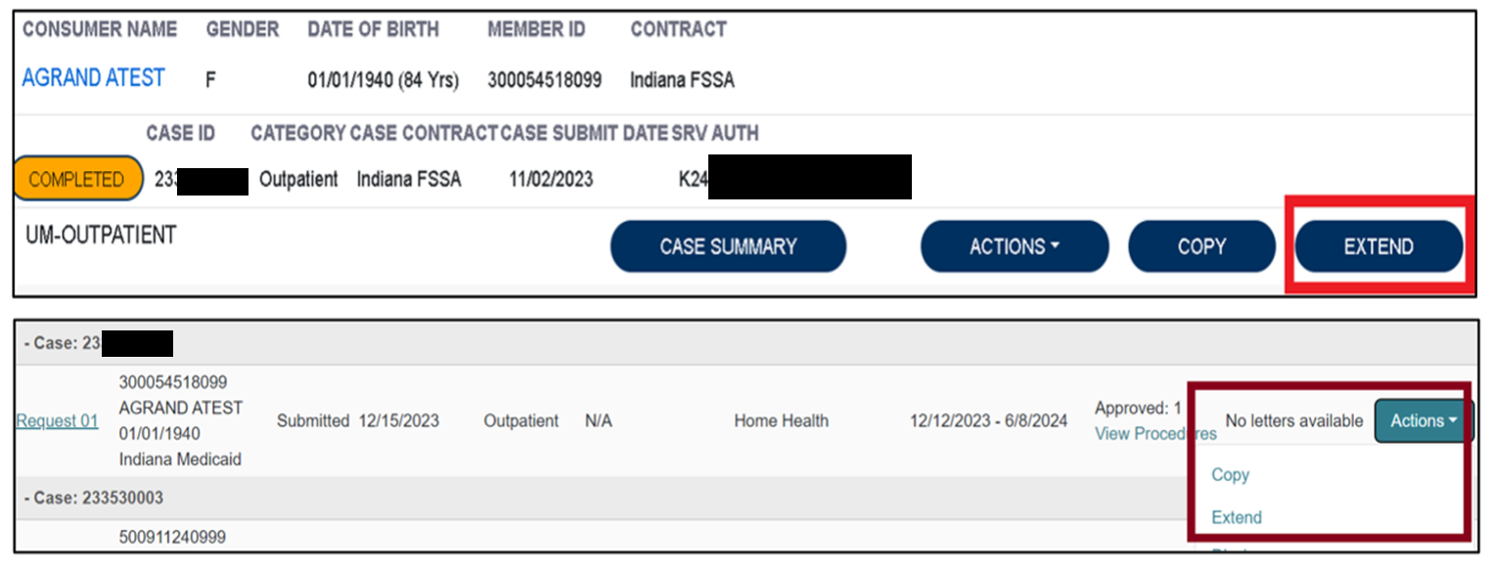
Additional Unit Requests Process
To begin, the user will choose to extend the existing PA. This can be done from the queue view or within the case itself.

Slide 16
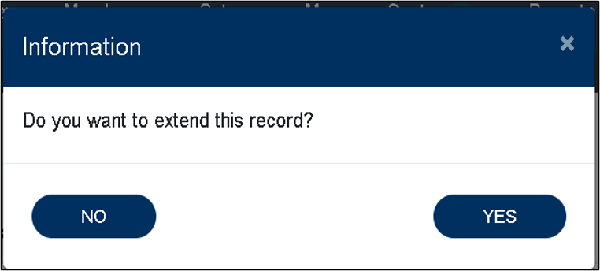
Request Process
The system will ask the user to verify the action by clicking YES.
Next the system will populate the case summary. Here the user will scroll to the Clinical section and select the down caret to expand the section.

Slide 17
Request Process Continued
The user will then scroll to the new request line.
The user will change the requested start date to the date the new units need to start.
*EXAMPLE: Original end date was 02/05/2024, this will populate as 02/06/2024 and will need to be changed.

Slide 18
Acknowledgement Attestation
Once the request line has been updated to reflect the new start date and requested units, the user will scroll to the bottom of the screen and check the box acknowledging that the PA is not a guarantee of payment and only identifies medical necessity, not benefits. The user will then click the submit button.

Slide 19
Authorization Revisions
Authorization Revision Request include:
Requests to move units between codes already approved.
If no additional units are needed but only the end date needs to be extended.

Slide 20
Transferring PAs Between Providers

Slide 21
Assuming a PA from Another Provider
Fax a request on the IHCP Prior Authorization Revision Request Form to 800-261-2774 or call customer service at 866-725-9991.
Provide all relevant information including but not limited to:
Member information
Originating provider information
Authorization number
Procedures on the PA request
Date PA will be assumed
Hospice providers are required to submit completed Hospice Provider Request Between Hospice Providers Form.

Slide 22
Transferring Outstanding PA’s
Providers should check eligibility before requesting or rendering service.
With any change in a Member’s assignment to FFS, notify Acentra of any current PA; included supporting documentation to substantiate PA.
Original PA letter must provide Acentra with the following:
Member ID (MID).
Provider’s National Provider Identifier (NPI).
Duration and frequency of authorization.
Fax letter with explanation of request: 800-261-2774.
When a member changes eligibility to Fee-For-Service (FFS) coverage from another vendor, Acentra honors existing PAs for specific durations, whichever comes first:
First 90 calendar days from member’s effective date in new plan.
Remainder of the PA dates of service.
Until approved units of service are exhausted.
*PA is not a guarantee of payment.

Slide 23
Hoosier HealthWise Member Disenrollment from Managed Care

Slide 24
Hoosier Healthwise Disenrollments
There is now a dedicated fax line for Hospice providers to send Hoosier Healthwise disenrollment requests.
The new Hospice Disenrollment Fax number is 1-800-922-9805.
The providers will still send the Medicaid Hospice Election form with a notation of Hospice Member Disenrollment from Managed Care in the subject line.
A follow up phone call to verify receipt is still recommended before 4 PM Eastern Time to ensure timely notification to Maximus.
Failure to follow these steps can result in a missed disenrollment.

Slide 25
Retrospective PAs

Slide 26
Retrospective Reviews
A retrospective review occurs when the entire date span of the request has past prior to submission. This is considered under the following circumstances:
Pending or retroactive member eligibility.
Provider unaware that the member was eligible for services at the time services were rendered. ***PA is granted in this situation only if the following conditions are met:
The provider’s records document that the member refused or was physically unable to provide the member’s IHCP Member ID.
The provider can substantiate that reimbursement was continually pursued from the member until IHCP eligibility was discovered.
The provider submitted the request for PA within 60 calendar days of the date that IHCP eligibility was discovered.
When requesting a retrospective PA, detailed information and documentation to explain the retro request is required.

Slide 27
PA with Third-Party Liability

Slide 28
Third-Party Liability (TPL)
For members with TPL primary insurance, the provider will:
Members with Medicare or Medicare Advantage plan primary insurance:
Follow the TPL authorization requirements
Obtain a PA from Acentra
Covered Medicare services do not require a Acentra authorization.
Services not covered by Medicare subject to IHCP PA requirements - PA must be obtained from Acentra.

Slide 29
Administrative Review and Appeal Process

Slide 30
Administrative Review of PA Determinations
Administrative Review (AR) for outpatient requests.
Must be received within 7 business days plus 3 calendar days of the date of the notification for an adverse determination.
Peer-to-Peer reviews.
If Provider chooses to complete a Peer-to-Peer conversation first, the provider has the same time frame to submit an administrative review request following that determination.
Inpatient hospitalizations a when member continues to be hospitalized:
Notification of intent to request review must be submitted within 7 business days plus 3 calendar days of the notification of modification or denial.
To continue with request, Acentra must receive entire medical record within 45 calendar days of discharge.

Slide 31
Initiating an Administrative Review
Provider must include the following information with the request:
All Documentation to support medical necessity for the request of an administrative review.
Summary letter to include:
Authorization number
Member’s Name
IHCP Member ID
Pertinent reasons the requested services are medically necessary.

Slide 32
Submitting an Administrative Review
Atrezzo Provider Portal
Fax
Mail
Select Reconsideration (from the actions drop down menu).
Enter a note and add documents.
800-261-2774
Acentra
6802 Paragon Place, Ste. 440
Richmond, VA 23230

Slide 33
Administrative Hearing Appeal Process
If Administrative Review decision is favorable: authorization effective on the originally requested date.
If decision is to uphold authorization denial: provider may file an Administrative Hearing Appeal (AHA) within 33 calendar days of adverse decision.
Members can appeal PA decision in writing:
Letter explaining why they think decision is wrong.
Letter must include member name and other important info (e.g., date of decision).

Slide 34
Additional Appeal Process Information
As required by statute: if request for hearing is received before effective date of denial/modification, services continue at the authorized level of previous PA.
If appellant is not the member: request must include documentation that appellant has legal right to act on behalf of member is required (e.g., Power of Attorney for Healthcare or legal guardianship papers).

Slide 35
Submitting an AHA
Mail
Fax
Email
Family and Social Service Administration/Office of Administrative Law Proceedings – FSSA Hearings
402 W. Washington St, Rm E034
Indianapolis, IN 46204
317-232-4412
fssa.appeals@oalp.in.gov

Slide 36
Common Denials

Slide 37
Common Reasons for Denials and Voids
ADMINISTRATIVE DENIALS:
Missing mandatory form(s) that is not received within 30 calendar days of pending to provider.
MEDICAL NECESSITY DENIALS:
Does not meet medical necessity
PARTIAL APPROVALS:
Dates/units may be modified according to date of submission.
Medical Necessity has not been met for the entire requested service.
VOIDS:
The request is a duplicate of another authorization submitted to Acentra Health.

Slide 38
Helpful Links

Slide 39
FSSA Resources for Providers
Provider Fee Schedules
Accessible from the Family and Social Services Administration (FSSA) Provider web page. Guides providers regarding PA requirement.
Fee Schedules
Provider Modules
Found in the providers references section. Guides providers on requirements.
Provider Modules
Forms
If prior authorization request requires forms to be submitted with request, they are located here.
Forms

Slide 40
Acentra Health’s Resources for Providers
Atrezzo: 24-hour/365 days provider portal accessed at: Atrezzo Provider Portal
Provider Education and Outreach, as well as system training materials (including Video recordings and FAQs) are located at: Acentra Provider training and education page
Provider communication and support email: INPriorAuthIssues@Acentra.com

Slide 41
Conclusion and Q&A
Thank you for your time!
Provider Relations Assistance:
INPriorAuthIssues@acentra.com
Provider education website:
Training & Education - Indiana Medicaid FFS (acentra.com)
Acentra Health Customer Service:
Phone: 866-725-9991
Fax: 800-261-2774

Slide 42
Closing slide

