Slide 1
Speech Therapy Prior Authorization Process
On behalf of Indiana Medicaid

Slide 2
Agenda
Acentra Health
General Authorization Requirements
Provider Responsibilities
Speech Therapy Overview
Tips for Reducing Pends and Administrative Denials
Post Denial Options
Atrezzo Process for Authorization Revisions and Requesting Additional Units

Slide 3



Acentra Health
With over six decades of combined experience, CNSI and Kepro have come together to become:
Currently, Acentra provides services in all 50 states, partnering with 45 state Medicaid agencies and 25 federal agencies.

Slide 4
About Acentra Health:
Acentra Health’s diverse team of experienced leaders, clinicians, technologists, and industry professionals are redefining industry standards and expectations to support your program’s needs.
30+ years of public sector health experience.
Innovative excellence in healthcare technology solutions and clinical expertise.
Best-in-class client experience: subject-matter experts, health care advisory board, board of directors, and client focus groups.
Acentra serves as the PA vendor for Indiana Medicaid FFS since July 1, 2023.

Slide 5
Utilization Management Scope of Services
Durable Medical Equipment (DME)
Audiology
Hospice
Inpatient Medical
Behavioral Health Reviews
TBI
Location 22
Outpatient Physical & Occupational therapy
Outpatient Speech Therapy
Physician Administered Drug (PAD)
Imaging/Lab/Genetic
Transplant
Home Health
Dental
Outpatient Surgery
Transportation
Vision
Chiropractic

Slide 6
Acentra Health’s Resources for Providers
Atrezzo: 24-hour/365 days the provider portal can be accessed at: https://atrezzo.acentra.com/
  Utilization of the Atrezzo portal allows the provider to:
        Request prior authorization for services and communicate with clinical reviewers.
        Upload clinical information to aid in review of prior authorization requests.
        Submit administrative reviews (reconsiderations) and/or peer-to-peer requests for services denied/partially approved.
Provider Education and Outreach, as well as system training materials (including Video recordings and FAQs) are located at: Training & Education - Indiana Medicaid FFS
Provider communication and support email: INPriorAuthIssues@Acentra.com

Slide 7
Timely Submission
A request is considered timely when the request is submitted prior to the start of services (unless submitted late due to retrospective Medicaid eligibility).
Acentra’s guides for submitting both outpatient and inpatient requests can be found on our Provider Education Website at: Training & Education - Indiana Medicaid FFS

Slide 8
Retrospective Reviews
A retrospective review occurs when the entire date span of the request has passed prior to submission. This is considered under the following circumstances:
Pending or retroactive member eligibility.
Provider unaware that the member was eligible for services at the time services were rendered. ***PA is granted in this situation only if the following conditions are met:
  The provider’s records document that the member refused or was physically unable to provide the member’s Indiana Health Coverage Programs (IHCP) Member ID.
  The provider can substantiate that reimbursement was continually pursued from the member until IHCP eligibility was discovered.
  The provider submitted the request for PA within 60 calendar days of the date that IHCP eligibility was discovered.
When requesting a retrospective PA, detailed information and documentation to explain the retro request is required.

Slide 9
Provider Responsibilities
Methods for Prior Authorization Submission:
  https://atrezzo.acentra.com/
  Fax: 800-261-2774
  Phone: 866-725-9991
Please check the FSSA’s Provider Fee Schedules prior to submission to ensure a prior authorization is required for the service being rendered.
Always verify the Member’s eligibility with Indiana Medicaid FFS via the IHCP provider portal.
Ensure that the request is not a duplication of services.
Complete all required forms in its entirety and submit all documentation with request for authorization.
**Prior authorization does not guarantee payment.

Slide 10
General Prior Authorization Requirements
Submitting via Portal
Submitting via Fax
Submitting via Phone
Atrezzo Provider Portal
Case Wizard provides step-by-step guidance through the case submission process.
Upload all required forms and relevant documentation at the time of submission.
Prior Authorization Request Form:
  Member Identification number
  Provider NPI both “Requesting” and “Rendering” (if different)
  CPT; CDT; REV; HCPCS; along with dates of service
  Diagnosis code
  Form must be signed
Submit all relevant documentation at the time of submission.
Provider must provide all the information from the Prior Authorization Request Form.
Then submit all relevant documentation either via portal, mail, or fax.
*Abbreviations: Dates of service (DOS), National Provider Identifier (NPI), Current Procedural Terminology (CPT), Current Dental Terminology (CDT), Revenue code (REV), & Healthcare Common Procedure Coding System (HCPCS)

Slide 11
Speech Therapy

Slide 12
Therapy Prior Authorization Exceptions
The following services do not require a prior authorization under therapy services:
  Initial Evaluations.
  Any combination of therapy services ordered in writing before a member’s release or discharge from an inpatient hospital, continuing for a period not to exceed 30 units in 30 calendar days.
  Deductible and copay or coinsurance for services covered by Medicare Part B.
  Therapy services provided by a nursing facility or large private or small intermediate care facility for individuals with intellectual disabilities (ICF/IID), which are included in the facility’s per diem rate.

Slide 13
Therapy Covered Services
IHCP covers:
  Rehabilitative therapy services for members under 21 years of age when determined medically necessary. For members 21 years of age and older, the IHCP covers rehabilitative therapy services for no longer than two years from the initiation of the therapy, unless a significant change in medical condition requires longer therapy.
  Habilitative therapy services for members under 21 years of age on a case-by-case basis, subject to prior authorization.

Slide 14
General Therapy Non-Covered Services
Therapy rendered for diversional, recreational, vocational or avocational purposes; for the remediation of learning disabilities; or for developmental activities that can be conducted by nonmedical personnel.
Educational services, including, but not limited to, the remediation of learning disabilities, are not considered habilitative therapy and are not covered.
Habilitative therapy is not a covered service for members 21 years of age and older.
IHCP does not separately reimburse for ongoing evaluations.
IHCP does not authorize requests for therapy that would duplicate other services provided to a member.

Slide 15
Therapy Non-Covered Services-ST Specific
Specific to Speech Therapy
Evaluations and reevaluations are limited to three hours of service per evaluation.
Group therapy is covered only in conjunction with, not in addition to, regular individual treatment. The IHCP will not reimburse for group therapy as the only or primary means of treatment.
The IHCP does not reimburse separately for speech pathology services provided by a nursing facility or large private or small ICF/IID. These services are included in the facility’s established per diem rate.
****All requests for services for members aged 20 and under are reviewed under EPSDT.****

Slide 16
Documentation and Order Requirements
IHCP requires written evidence of physician involvement and personal patient evaluation to document acute medical needs.
Providers must attach a current plan of treatment and progress notes indicating the necessity and effectiveness of therapy to the PA request and make this documentation available for audit.
Speech Therapy Orders
The therapy must be ordered by a qualifying provider:
  Physician
  Nurse practitioner
  Clinical nurse specialist
  Certified nurse midwife
  Physician assistant

Slide 17
Documentation Requirements
Providers must attach a current plan of treatment and progress notes indicating the necessity and effectiveness of therapy to the PA request and make this documentation available for audit.
Providers will want to show a current clinical picture of the member within 90 days of the requested date of service.
  Plan of Care (POC) should include:
    Current assessment/ Member description of problem.
      Objective data and measurements within the assessment.
    Goals and progress towards those goals.
    Frequency/duration of each code requested.
    Prognosis and member/member representative agrees to the POC.

Slide 18
Speech Therapy Unit/Modifier Requirements
ST codes are requested as 1 unit per visit.
There are no required modifiers on Speech Therapy PA requests.
  There will not be an option for modifiers when submitting a ST case
The modifier HM is a claims only modifier and is not required on the PA itself.
*****Please reference the IHCP Provider Code Tables:
Code Sets

Slide 19
Common Reasons for Denials and Voids
ADMINISTRATIVE DENIALS:
Missing mandatory form(s) that is not received within 30 days of receipt of the PA request.
MEDICAL NECESSITY DENIALS:
Does not meet medical necessity.
PARTIAL APPROVALS:
Dates/units may be modified according to date of submission.
Medical Necessity has not been met for the entire requested service.
VOIDS:
The request is a duplicate of another authorization submitted to Acentra Health.

Slide 20
Tips to Reduce Pends and Denials
Upload all required documentation at the time of submission.
Include all required forms and service specific documentation when submitting the request.
Verify:
  All required forms are filled out completely and contain proper signatures as required.
  The request has not been previously submitted.
  The member is not receiving services from a different provider.
  The units requested match the units/visits on the plan of care.
Ensure to obtain a PA prior to rendering services.
Provide any missing documentation within 30 calendar days of the date the case was received by Acentra.

Slide 21
Prior Authorization Review Process
After submission of a request, one of the following actions will occur:​
  Approval: Request met criteria either at nurse review level or medical director review.
  Pended request for additional information: Required documentation is requested when not included with the original submission.

Slide 22
Prior Authorization Review Process Continued
  Administrative Denial:
  Denial of services due to:
    Untimely Request
    Requested information not received
  ​Medical Necessity Denial:
  Physician has determined that medical necessity has not been met.
  The Physician may partially approve or fully deny a request.​

Slide 23
Administrative Review/Reconsideration
  If an administrative denial or medical necessity denial is issued, the provider can request an Administrative Review (also known as Reconsideration).
  The provider MUST submit a request for administrative review to Acentra Health within 7 business days plus 3 calendar days of the date provided on the initial adverse determination letter.
  How to request an administrative review:
    Request from the “actions” drop down in the Provider Portal.
    Fax written request.
    Provider module contains details of what is required to initiate an administrative review: Prior Authorization Module
  The review will be completed within 7 business days of receipt.

Slide 24
Peer-to-Peer
  Providers may request a Peer-to-Peer on a medical necessity adverse determination.
  Requests for a peer to peer must be made within 7 business days plus 3 calendar days of the date provided on the initial adverse determination letter.
  To request a peer to peer:
    Request from the “actions” drop down in the Provider Portal. Provide the ordering provider’s full name, phone number, and three dates and times of availability.
    Call Customer Service at 866-725-9991.
    Once an agreeable date and time have been identified, a representative will contact (via telephone) the provider with the confirmed date and time. A note will also be placed in the case that is visible to the provider.

Slide 25
Turnaround Times
The turnaround time for completion of a prior authorization review ensures: ​
​A thorough and quality review of all requests by reviewing all necessary & required documentation when it is received.
Ensuring a prompt decision is made to facilitate member care.
Standard
Expedited review
5 business days
48 clock hours
Concurrent Review
Retrospective Review
48 clock hours
30 calendar days

Slide 26
Process For Requesting Additional Units
To request additional units, providers will need to extend the existing PA by selecting the extend button within the case or from “actions” drop down for the case in the queue.
The user will need to update the start date to reflect the date that the new units need to begin. (E.G. the current PA has an end date of 02/05/2024 but the units have been exhausted as of 01/20/2024, the provider will change the auto-populated start date from 02/06/2024 to 01/21/2024).
Provider can delete all additional codes that do not need to be extended. (Each code will have a trash can icon)

Slide 27
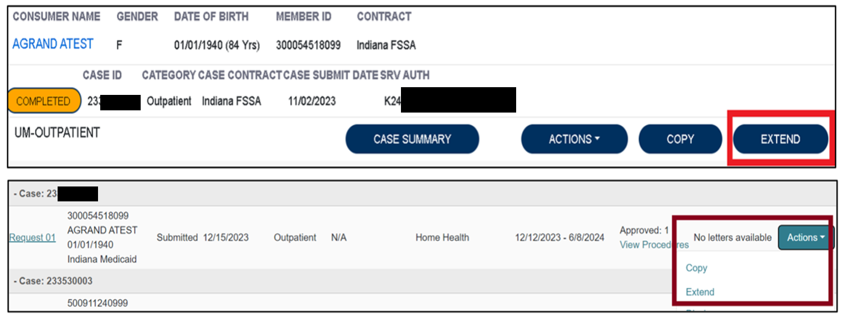
Additional Unit Requests Process
To begin, the user will choose to extend the existing PA. This can be done from the work queue view or within the case itself.

Slide 28
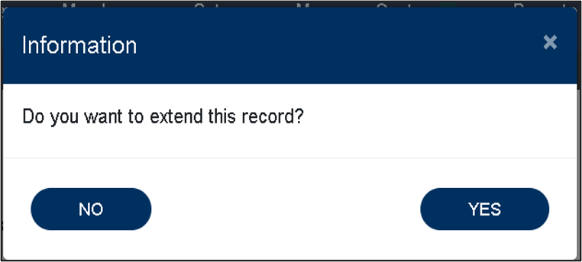

Screenshots for Additional Units Continued
The system will ask the user to verify the action by clicking YES.
Next the system will populate the case summary. Here the user will scroll to the Clinical section and select the down caret to expand the section.
Notes:
The system will ask you to verify that you do wish to extend the case and will then display the case overview. On the case overview, you will scroll to the clinical section and use the down carat to expand the section to enter the request information.

Slide 29
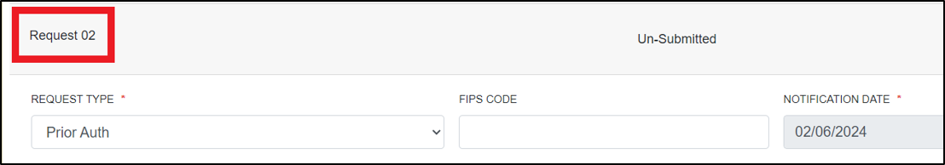
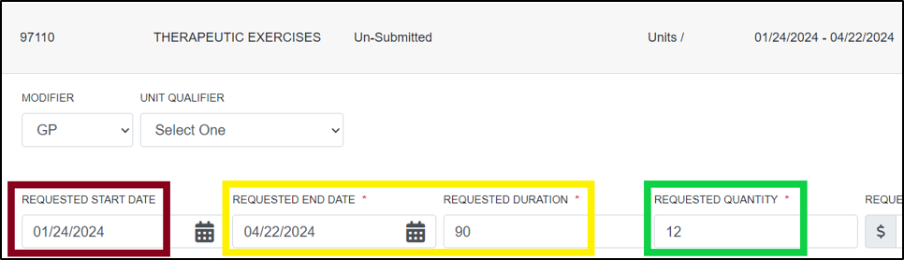
Additional Units Screenshots Continued
The user will then scroll to the new request line.
The user will change the requested start date to the date the new units need to start.
*EXAMPLE: Original end date was 02/05/2024, this will populate as 02/06/2024 and will need to be changed.)
NOTE***If additional procedure codes populate where additional units are not needed, delete the additional codes.
Notes:
The new request line will vary depending on the number of times the PA has had requests made. Again, it is important that the start date is updated as it auto-populates to the day following the original request’s end date. You will remove any codes you do not need additional units on by selecting the trash can icon and selecting the deactivation reason of entered in error.

Slide 30
Final Additional Units Screenshot
Once the request line has been updated to reflect the new start date and requested units, the user will scroll to the bottom of the screen and check the box acknowledging that the PA is not a guarantee of payment and only identifies medical necessity, not benefits.
The user will then click the submit button.
Notes:
You can add documents by expanding the attachments section and selecting to add a document. When you have updated all information in the new request line, you will scroll to the bottom of the page, click the check box to verify that you agree with the terms and then submit. This will complete the process to request the additional units.

Slide 31

Authorization Revision Request
Requests to move units from one code to another will continue to be an Authorization Revision Request.
If the need to move units coincides with an additional units request, enter the extension and an authorization revision request.
If no additional units are needed but the end date needs to be extended, this would also be an Authorization Revision Request.

Slide 32
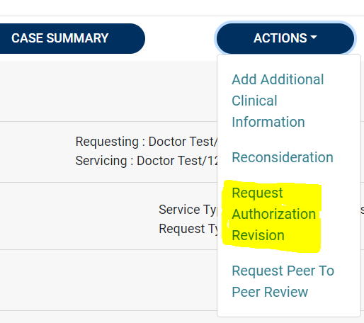
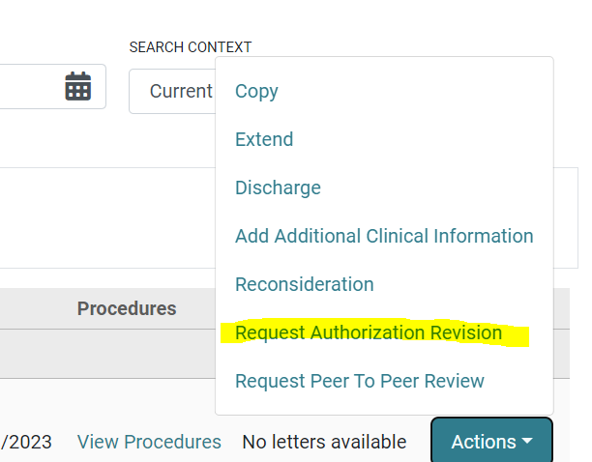
Authorization Revision Request Screenshot

Slide 33
Assuming a PA From Another Provider
Fax a request on the Authorization Revision Request form to 800-261-2774 or call customer service at 866-725-9991.
Provide all relevant information including but not limited to:
  Member information
  Originating provider information
  Authorization number
  Procedures on the PA request
  Date PA will be assumed

Slide 34
FSSA Resources for Providers
Provider Fee Schedules
  Accessible from the Family and Social Services Administration (FSSA) Provider web page. Guides providers regarding PA requirement.
  Provider Fee Schedules
Provider Modules
  Found in the providers references section. Guides providers on requirements.
  Provider Modules
Forms
  If prior authorization request requires forms to be submitted with the request, they can be found on the forms page.
  Forms

Slide 35
Conclusion and Q&A
Thank you for your time and participation!
Provider Relations Assistance:
INPriorAuthIssues@acentra.com
Provider education website:
Training & Education - Indiana Medicaid FFS
Acentra Health Customer Service:
Phone: 866-725-9991
Fax: 800-261-2774

Slide 36
Closing slide

