Slide 1
Durable Medical Equipment Prior Authorization Process
On behalf of Indiana Medicaid

Slide 2
Agenda
Acentra Health
General Authorization Requirements
Provider Responsibilities
Durable Medical Equipment Overview
Tips for Reducing Pends and Administrative Denials
Post Denial Options
Atrezzo Process for Authorization Revisions and Requesting Additional Units

Slide 3
Acentra Health
With over six decades of combined experience, CNSI and Kepro have come together to become:
Currently, Acentra provides services in all 50 states, partnering with 45 state Medicaid agencies and 25 federal agencies.

Slide 4
About Acentra Health:
Acentra Health’s diverse team of experienced leaders, clinicians, technologists, and industry professionals are redefining industry standards and expectations to support your program’s needs.
30+ years of public sector health experience.
Innovative excellence in healthcare technology solutions and clinical expertise.
Best-in-class client experience: subject-matter experts, health care advisory board, board of directors, and client focus groups.
Acentra serves as the PA vendor for Indiana Medicaid FFS since July 1, 2023.

Slide 5
Utilization Management Scope of Services
Durable Medical Equipment (DME)
Audiology
Hospice
Inpatient Medical
Behavioral Health Reviews
TBI
Location 22
Outpatient Physical & Occupational therapy
Outpatient Speech Therapy
Physician Administered Drug (PAD)
Imaging/Lab/Genetic
Transplant
Home Health
Dental
Outpatient Surgery
Transportation
Vision
Chiropractic

Slide 6
Acentra Health’s Resources for Providers
Atrezzo: 24-hour/365 days the provider portal can be accessed at: Atrezzo Provider Portal
Utilization of the Atrezzo portal allows the provider to:
Request prior authorization for services and communicate with clinical reviewers.
Upload clinical information to aid in review of prior authorization requests.
Submit administrative reviews (reconsiderations) and/or peer-to-peer requests for services denied/partially approved.
Provider Education and Outreach, as well as system training materials (including Video recordings and FAQs) are located at: Training & Education - Indiana Medicaid FFS
Provider communication and support email: INPriorAuthIssues@Acentra.com

Slide 7
Timely Submission
A request is considered timely when the request is submitted prior to the start of services (unless submitted late due to retrospective Medicaid eligibility).
Acentra’s guides for submitting both outpatient and inpatient requests can be found on our Provider Education Website at: Training & Education - Indiana Medicaid FFS

Slide 8
Retrospective Reviews
A retrospective review occurs when the entire date span of the request has passed prior to submission. This is considered under the following circumstances:
Pending or retroactive member eligibility.
Provider unaware that the member was eligible for services at the time services were rendered. ***PA is granted in this situation only if the following conditions are met:
The provider’s records document that the member refused or was physically unable to provide the member’s Indiana Health Coverage Programs (IHCP) Member ID.
The provider can substantiate that reimbursement was continually pursued from the member until IHCP eligibility was discovered.
The provider submitted the request for PA within 60 calendar days of the date that IHCP eligibility was discovered.
When requesting a retrospective PA, detailed information and documentation to explain the retro request is required.

Slide 9
Provider Responsibilities
Methods for Prior Authorization Submission:
Atrezzo Provider Portal
Fax: 800-261-2774
Phone: 866-725-9991
Please check the FSSA’s Provider Fee Schedules prior to submission to ensure a prior authorization is required for the service being rendered.
Always verify the Member’s eligibility with Indiana Medicaid FFS via the IHCP provider portal.
Ensure that the request is not a duplication of services.
Complete all required forms in its entirety and submit all documentation with request for authorization.
**Prior authorization does not guarantee payment.

Slide 10
General Prior Authorization Requirements
Submitting via Portal
Submitting via Fax
Submitting via Phone
Atrezzo Provider Portal
Case Wizard provides step-by-step guidance through the case submission process.
Upload all required forms and relevant documentation at the time of submission.
Prior Authorization Request Form:
Member Identification number
Provider NPI both “Requesting” and “Rendering” (if different)
CPT; CDT; REV; HCPCS; along with dates of service
Diagnosis code
Form must be signed
Submit all relevant documentation at the time of submission.
Provider must provide all the information from the Prior Authorization Request Form.
Then submit all relevant documentation either via portal, mail, or fax.
*Abbreviations: Dates of service (DOS), National Provider Identifier (NPI), Current Procedural Terminology (CPT), Current Dental Terminology (CDT), Revenue code (REV), & Healthcare Common Procedure Coding System (HCPCS)

Slide 11
Common Reasons for Denials and Voids
ADMINISTRATIVE DENIALS:
Missing mandatory form(s) that is not received within 30 days of receipt of the PA request.
MEDICAL NECESSITY DENIALS:
Does not meet medical necessity.
PARTIAL APPROVALS:
Dates/units may be modified according to date of submission.
Medical Necessity has not been met for the entire requested service.
VOIDS:
The request is a duplicate of another authorization submitted to Acentra Health.

Slide 12
Durable Medical Equipment

Slide 13
DME Prior Authorization Exceptions
Commonly Requested DME Codes that do not require a prior authorization
E0601 Continuous Airway Pressure (CPAP) device
E0185 Gel or gel-like pressure pad for mattress, standard mattress length and width
E0971 Manual Wheelchair (WC) accessory, anti-tipping device
K0739 Repair or nonroutine service for durable medical equipment other than oxygen equipment.
IHCP Fee Schedules

Slide 14
DME Covered Services
IHCP covers:
Durable Medical Equipment (DME): Examples include, but are not limited to, Wheelchairs, (both manual, power wheelchairs, and scooters), walkers, and Hospital beds.
Home Medical Equipment (HME): Examples include but are not limited to Oxygen (O2) equipment, Monitors and meters.
Medical Supplies are items that are disposable, nonreusable and must be replaced on a frequent basis.
Manually Priced DME, HME and Supplies. An example of a manually priced HCPCS code is E1399- Durable medical equipment, not otherwise specified. These codes must always include a manufacturer’s retail price for each item listed under the code E1399.
Repair and Servicing. All repairs of purchased DME or HME require a prior authorization.

Slide 15
DME Non-Reimbursed Services
The IHCP does not reimburse claims for equipment and supplies included in the facility per diem rate for members residing in in long-term care (LTC) facilities, nursing facilities and ICFs/IID, community residential facilities for the developmentally disabled and group homes.
Repair costs included in an LTC facility’s per diem rate are also not separately reimbursable.
Per diem code table

Slide 16
Documentation Requirements
DME and Medical Supplies
Order submitted must be signed by a qualifying provider:
Physician
Nurse Practitioner
Clinical nurse specialist
Certified nurse midwife
Physician assistant
Dentist
Services requiring CMN forms
Augmentative communications system
CMN for Oxygen
Enteral and Parenteral Nutrition
Hospital and Specialty Beds
Motorized Wheelchair purchase
Negative Pressure Wound Therapy
Nonmotorized Wheelchair Purchase
Standing Equipment
TENS (Transcutaneous Electrical Nerve Stimulator) Unit.
IHCP Forms

Slide 17
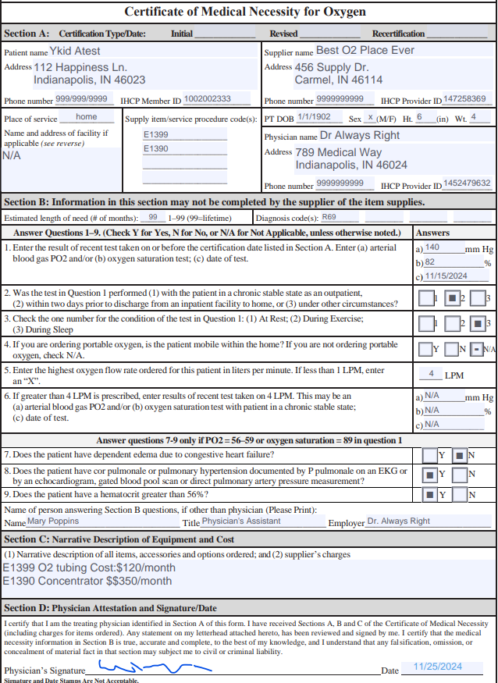
Example CMN form

Slide 18
Documentation Requirements continued
For the IHCP to cover the following equipment, the face-to-face visit must occur and be recorded no more than six months before the start of services:
Compression devices
Decubitus care equipment
Hospital beds and accessories
Humidifiers, compressors, nebulizers
Infusion supplies
Monitoring devices
Nerve stimulators and devices
Oxygen and related respiratory equipment
Patient lifts
Speech generating devices
Traction equipment
Ultraviolet light devices
Wheelchairs and wheelchair accessories
Whirlpool equipment

Slide 19
DME Modifier Requirements
Please refer to the provider module linked below for the specific codes requiring one of the following modifiers:
Rental: RR modifier
Purchase: NU modifier
Incontinence Supplies: modifier U9
Durable and Home Medical Equipment and Supplies

Slide 20
Capped Rented Equipment
The IHCP limits certain DME and HME items to a set number of months of continuous rental.
The capped rental period is either six, ten, or fifteen months.
Capped rental code table

Slide 21
Benefit Limitation
The IHCP does not authorize replacement of large DME or HME items (such as custom/special wheelchairs, hospital beds, and lifts, AAC device) more than once every five years per member, unless there is a change in the member’s medical needs.
IHCP reimbursement is limited to one nonmotorized wheelchair, motorized wheelchair or POV per five-year period, unless a change in the member’s medical needs is documented in writing by the requesting provider.
*All request for services for members under 20 are reviewed under EPSDT

Slide 22
Date Span Requirements
Enteral and Parenteral Nutrition: Initial PA request is limited to three months, with subsequent PA requests for nine months and then eighteen months.
High-Frequency Chest Oscillation Systems: Requires a three-month rental before purchase.
Negative Pressure Wound Therapy: Authorized for only four weeks at a time.
Oxygen: Initial certification is limited to three months. The IHCP members who fall into Group III, may request a PA to up to twelve months, depending on the medical necessity demonstrated in the documentation provided. See IHCP bulletin BT202242.

Slide 23
Lifetime Oxygen and Ventilator requirements
If submitted through the Atrezzo Provider Portal: Providers will have to respond to the question asking if the member will require supplemental oxygen for their lifetime. For lifetime oxygen users, the authorization must be submitted for a 365-day date of service with units reflecting 12. (1 unit per month) Providers are required to submit the CMN as an attachment.
If submitted by phone, Providers must indicate in the PA request that the member is a “lifetime” user and use the “99” as an indicator per the descriptor section of the CMN.
IHCP bulletin regarding Lifetime O2:
BT2023136

Slide 24
Lifetime O2 and Ventilator Questionnaire
When entering a request for lifetime oxygen or ventilator there will be a questionnaire that must be completed with accurate information.
On the questionnaire tab, the populated questionnaire will show. The user will click on Open to access the questions.

Slide 25
Overview of questionnaire
The lifetime questionnaire is one question. Answer the question and click Mark as complete to continue with the submission.

Slide 26
Questionnaires
Under the DME service type, there are other items that may have a questionnaire generate when requested.
When submitted via the portal, questionnaires are generated based on request types and circumstances. These questionnaires allow for a rules driven authorization process, possibly allowing for quicker turn around times on cases.
Service items included but not limited to:
Transfer benches
Hydraulic lifts
Shower chairs
Semi electric beds
Seat lifts

Slide 27
Tips to Reduce Pends and Denials
Upload all required documentation at the time of submission.
Include all required forms and service specific documentation when submitting the request. Verify:
All required forms are filled out completely and contain proper signatures as required.
Signed physician order has been included in request.
The request has not been previously submitted.
The member is not receiving services from a different provider.
Ensure to obtain a PA prior to rendering services.
Provide any missing documentation within 30 calendar days of the date the case was received by Acentra.

Slide 28
Prior Authorization Review Process
After submission of a request, one of the following actions will occur:​
Approval: Request met criteria either at nurse review level or medical director review.
Pended request for additional information: Required documentation is requested when not included with the original submission.

Slide 29
Prior Authorization Review Process Continued
Administrative Denial:
Denial of services due to:
Untimely Request
Requested information not received
​Medical Necessity Denial:
Physician has determined that medical necessity has not been met.
The physician may partially approve or fully deny a request.​

Slide 30
Administrative Review/Reconsideration
If an administrative denial or medical necessity denial is issued, the provider can request an Administrative Review (also known as Reconsideration).
The provider MUST submit a request for administrative review to Acentra Health within 7 business days plus 3 calendar days of the date provided on the initial adverse determination letter.
How to request an administrative review:
Request from the “actions” drop down in the Provider Portal.
Fax written request.
Provider module contains details of what is required to initiate an administrative review: Prior Authorization Module
The review will be completed within 7 business days of receipt.

Slide 31
Peer-to-Peer
Providers may request a Peer-to-Peer on a medical necessity adverse determination.
Requests for a peer to peer must be made within 7 business days plus 3 calendar days of the date provided on the initial adverse determination letter.
To request a peer to peer:
Request from the “actions” drop down in the Provider Portal. Provide the ordering provider’s full name, phone number, and three dates and times of availability.
Call Customer Service at 866-725-9991.
Once an agreeable date and time have been identified, a representative will contact (via telephone) the provider with the confirmed date and time. A note will also be placed in the case that is visible to the provider.

Slide 32
Turnaround Times
The turnaround time for completion of a prior authorization review ensures: ​
​A thorough and quality review of all requests by reviewing all necessary & required documentation when it is received.
Ensuring a prompt decision is made to facilitate member care.
Standard
Expedited review
5 business days
48 clock hours
Concurrent Review
Retrospective Review
48 clock hours
30 calendar days

Slide 33
Process For Requesting Additional Units
To request additional units, providers will need to extend the existing PA by selecting the extend button within the case or from “actions” drop down for the case in the queue.
The user will need to update the start date to reflect the date that the new units need to begin. (e.g. the current PA has an end date of 02/05/2024 but the units have been exhausted as of 01/20/2024, the provider will change the auto-populated start date from 02/06/2024 to 01/21/2024).
Provider can delete all additional codes that do not need to be extended. (Each code will have a trash can icon)

Slide 34
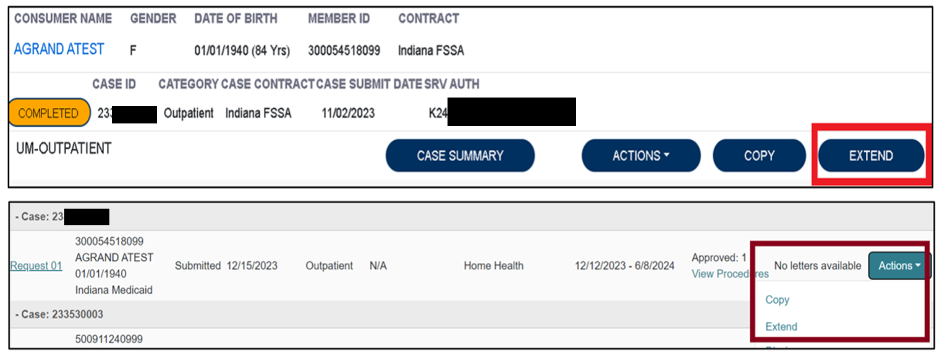
Additional Unit Requests Process
To begin, the user will choose to extend the existing PA. This can be done from the work queue view or within the case itself.

Slide 35
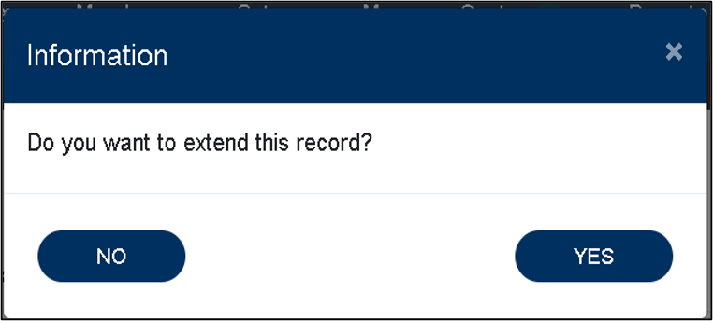
Screenshots for Additional Units Continued
The system will ask the user to verify the action by clicking YES.
Next, the system will populate the case summary. Here the user will scroll to the Clinical section and select the down caret to expand the section.

Slide 36
Additional Units Screenshots Continued
The user will then scroll to the new request line.
The user will change the requested start date to the date the new units need to start.
*EXAMPLE: Original end date was 02/05/2024, this will populate as 02/06/2024 and will need to be changed.)
NOTE***If additional procedure codes populate where additional units are not needed, delete the additional codes.

Slide 37
Final Additional Units Screenshot
Once the request line has been updated to reflect the new start date and requested units, the user will scroll to the bottom of the screen and check the box acknowledging that the PA is not a guarantee of payment and only identifies medical necessity, not benefits.
The user will then click the submit button.

Slide 38
Authorization Revision Request
Requests to move units from one code to another will continue to be an Authorization Revision Request.
If the need to move units coincides with an additional units request, enter the extension and an authorization revision request.
If no additional units are needed but the end date needs to be extended, this would also be an Authorization Revision Request.

Slide 39
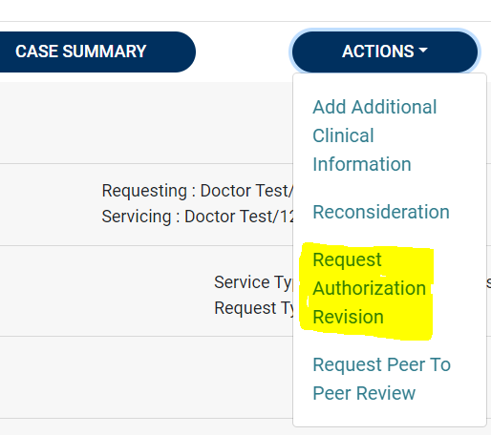
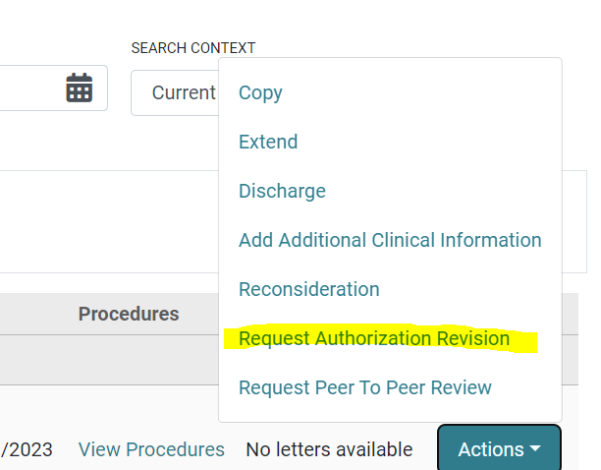
Authorization Revision Request Screenshot

Slide 40
Assuming a PA From Another Provider
Fax a request on the Authorization Revision Request form to 800-261-2774 or call customer service at 866-725-9991.
Provide all relevant information including but not limited to:
Member information
Originating provider information
Authorization number
Procedures on the PA request
Date PA will be assumed

Slide 41
FSSA Resources for Providers
Provider Fee Schedules
Accessible from the Family and Social Services Administration (FSSA) Provider web page. Guides providers regarding PA requirement.
Provider Fee Schedules
Provider Modules
Found in the providers references section. Guides providers on requirements.
Provider Modules
Forms
If prior authorization request requires forms to be submitted with the request, they can be found on the forms page.
Forms

Slide 42
Conclusion and Q&A
Thank you for your time and participation!
Provider Relations Assistance:
INPriorAuthIssues@acentra.com
Provider education website:
Training & Education - Indiana Medicaid FFS
Acentra Health Customer Service:
Phone: 866-725-9991
Fax: 800-261-2774

Slide 43
Closing slide

