Slide 1
PROCESS FOR ADDITONAL UNIT REQUESTS
Process Implementation Provider Education 2024

Slide 2
Outline of the new process for requesting additional units.
To request additional units, providers will need to extend the existing prior authorization (PA) by selecting the extend button within the case or from “actions” drop down for the case in the queue. The user will need to update the start date to reflect the date that the new units need to begin. (E.G. the current PA has an end date of 02/05/2024 but the units have been exhausted as of 01/20/2024, the provider will change the auto-populated start date from 02/06/2024 to 01/21/2024). The only exception to the date changes is for MRO packages. Providers will still use the extend feature but will keep the DOS the same as the existing request time.
Provider can delete all additional codes that do not need to be extended.
On the next several slides, we will go over each screen within the Atrezzo Provider Portal to demonstrate this new process in detail.

Slide 3
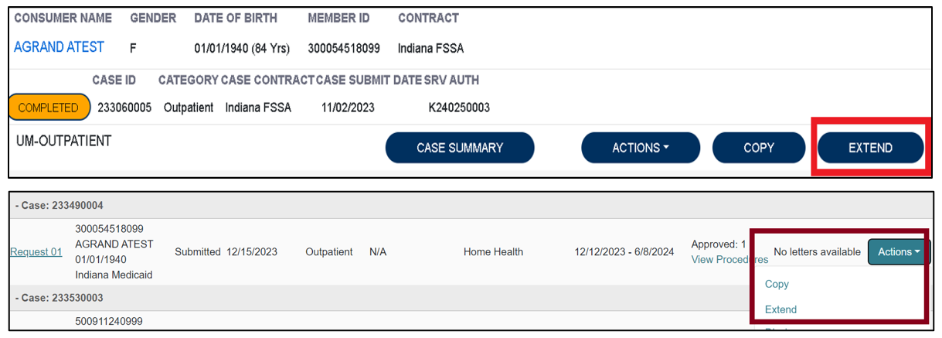
Additional Unit Requests Process, continued slide 2
To begin, the user will choose to extend the existing PA. This can be done from the queue view or within the case itself.

Slide 4
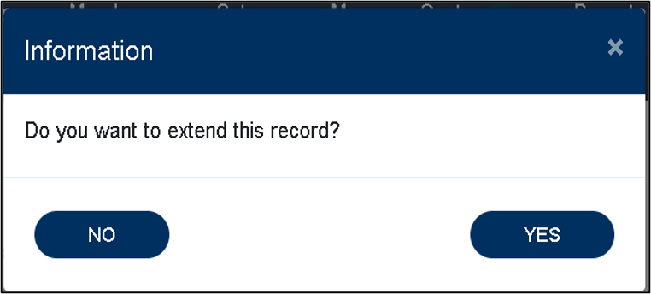
Additional Unit Requests Process, continued slide 3
Next the system will populate the case summary. Here the user will scroll to the Clinical section and select the down carat to expand the section.
The system will ask the user to verify the action by clicking YES.

Slide 5
Additional Unit Requests Process, continued slide 4
The user will change the requested start date to the date the new units need to start.
The user will then scroll to the new request line.
This will vary depending on how many extensions the case has had previously.
It is important that this is updated as it auto-populates to the day following the original request’s end date.
( E.G. original end date was 02/05/2024, this will populate as 02/06/2024 and will need to be changed.) NOTE***If additional procedure codes populate where additional units are not needed, delete the additional codes.
This change of dates does exclude MRO. MRO request lines will have the same date span as the original request line.

Slide 6
Additional Unit Requests Process, continued slide 5
Once the request line has been updated to reflect the new start date and requested units, the user will scroll to the bottom of the screen and check the box acknowledging that the PA is not a guarantee of payment and only identifies medical necessity, not benefits. The user will then click the submit button.

Slide 7
Additional situations and contact information.
Requests to move units will continue to be an Authorization Revision Request.
If no additional units are needed but the end date needs to be extended, this would also be an Authorization Revision Request.
MRO has special requirements for the extension DOS. They remaim the same as the initial request line.
Contact Support Center:
Phone: 866-725-9991
Fax 800-261-2774
Email for questions: INPriorAuthIssues@Acentra.com

Slide 8
End page with Acentra Logo

